Slide 1
Welcome to Web design 1
Yukiko Ishida

Slide 2
What will you learn?
Design and code web sites with multiple pages
Interact with the web systems that provide hosting
Move and manage files on a remote server
Analyze and discuss how web pages are created and displayed in the browser
Notes:
Designing basic sites & Working with files

Slide 3

Denai Avila

Slide 4
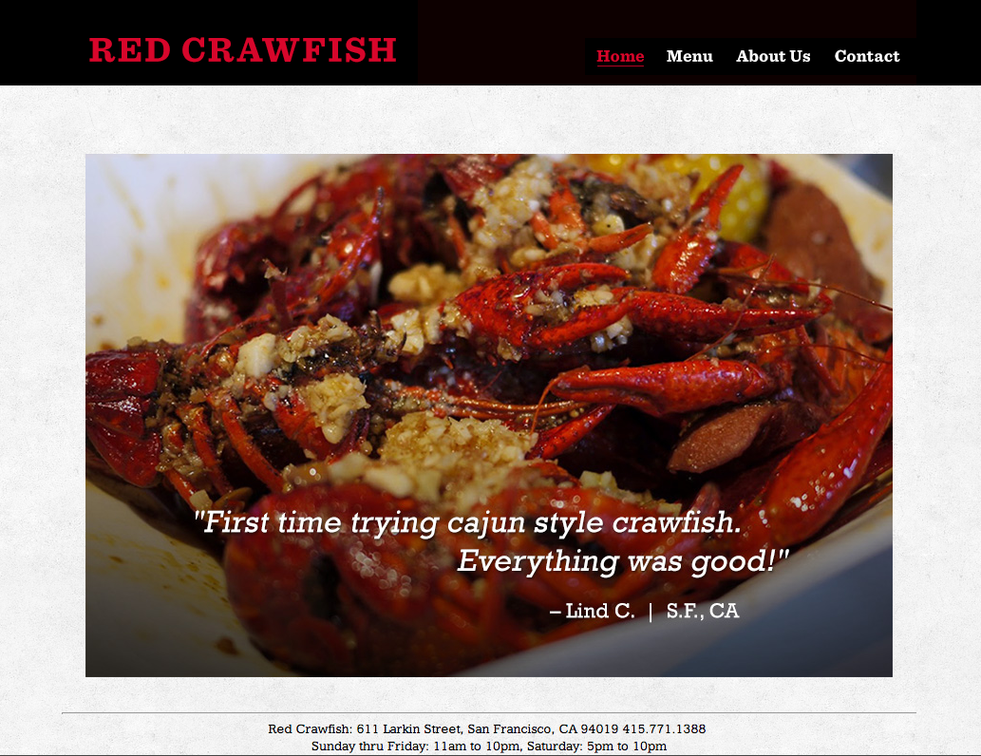
Eric Feng

Slide 5

HTML/CSS Ninjas
Write industry standard HTML and CSS
Utilize the core tags that define HTML in original web site designs
Design and code web pages using float, clear and background images
Notes:
Not focussing on software: photoshop illustrator, dreamweaver, fireworks.

Slide 6

Zihang Jiao

Slide 7

Ashley Gallardo

Slide 8
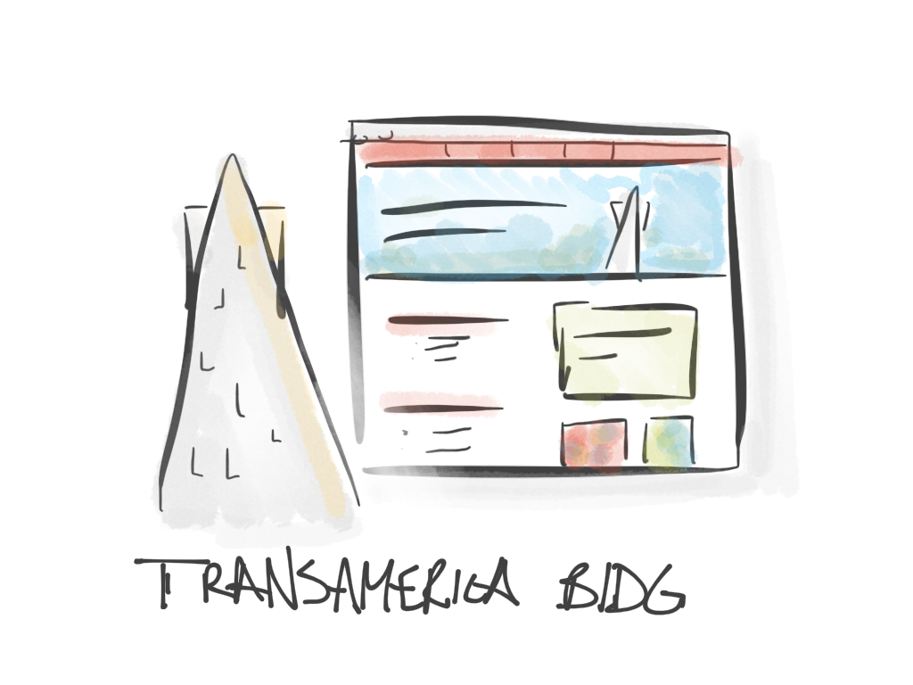
Landmark Website

Slide 9

A step in your education
Prerequisites:
Next: Web Design 2
Design technology
Visual design principles
Responsive design
Javascript
jQuery, Dom manipulation
WEB DESIGN 3
Content management systems
CSS frameworks
Media queries
Notes:
You should have basic software skills like how to use photoshop. We’ll be reinforcing previous concepts within the area of website design. Questions, talk to me after class

Slide 10
Questions?
-- Pause --
Notes:
About content of the class?
If unsure if class is right for you, we can talk during break

Slide 11
A word of warning…
Fast paced class!
Steep learning curve
Organization & details matter
Like learning a language

Slide 12
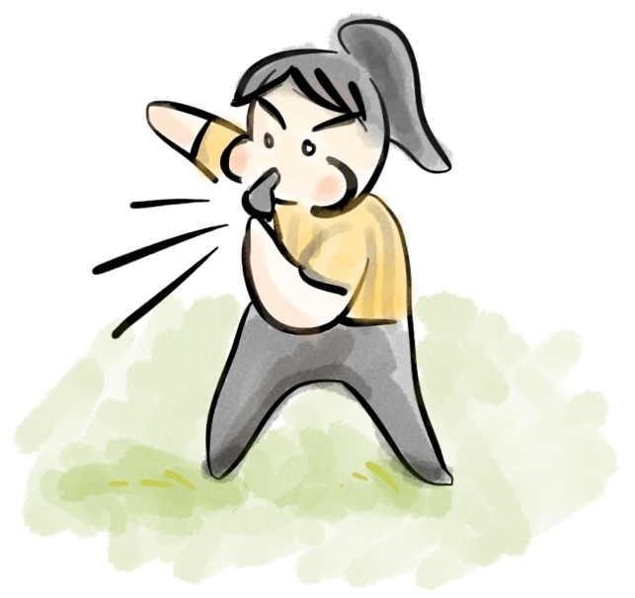
Ground Rules
Grading
Plagiarism
Participation

Slide 13
Grading is Impartial
Assignments turned in on-time
Consistent progress, participation in class
Parents, GPA, Financial aid
"Dear Student, Show up to class every week and be ready to learn. Make sure you stay up on your homework, and if you have any questions ask for help.” - CD

Slide 14
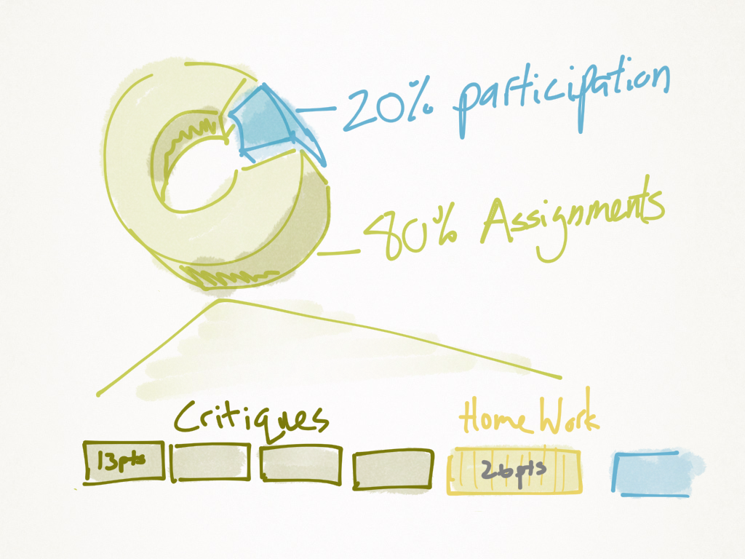

Slide 15
No plagiarism
Own photography, images
Legally obtained stock. Creative commons, purchased, explicit permission for use
Code needs to be modified substantially for own use

Slide 16
Don’t miss class
7pm - 9:50pm SHARP
~15min break in the middle
No make-up classes, notes
Critiques mandatory
“Don't miss class, you will get behind very fast.” -DA
Notes:
If you are sick. Still need to turn in via email Doctors note needed

Slide 17
In-class work
I’ll demo code to help you learn
Take notes
Bring your files to class
“Do the demos alongside Yukiko in class. It's the best way to remember them. Also, troubleshooting is where you learn the most. It's not broken, it's just not done yet.” - PP

Slide 18
Critiques
3 critiques (each worth the same)
Review site on web
Must present for grade – no hiding!
Unexcused late presentations lose 2 letter grades

Slide 19
Supplies & tools
Code editing software
FTP software (transfers your files)
Photoshop
Hosting / Domain name
Consistent internet access

Slide 20

optional
Notebook
Book (optional)
HTML and CSS: Design and Build Websites
John Duckett

Slide 21
Write this down
www.Yukikodesign.com/aau/web1
yukiko.ishida.aau@gmail.com

